Slide 1
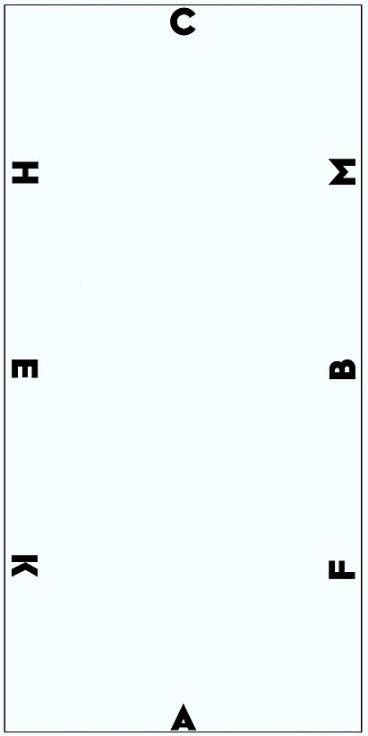
G
X
D

Slide 2
G
X
D

Slide 3
G
Now trot
Nu draf
Walk
(not in trot)
Arbeid stap
(niet in draf)
X
D

Slide 4
In trot
In draf
G
X
D

Slide 5
G
X
D

Slide 6
G
X
D

Slide 7
G
X
D

Slide 8
G
X
D

Slide 9
G
Stand still for 4 seconds
X
D

Slide 10
G
Voorwaarts in arbeidsstap;
Linkerhand, overgang draf
X
Forward in walk;
Left hand into trot
D

Slide 11
Arbeids-galop
G
X
D
Begin Canter

Slide 12
Arbeids-galop
G
X
Grote volte x 2
D
In Canter

Slide 13
Arbeids-draf
G
X
D
Transition to trot

Slide 14
Arbeidsdraf
G
X
D
In trot

Slide 15
G
Arbeidsgalop rechts
X
Start gallop
right hand
D

Slide 16
Arbeidsgalop rechts
G
X
D
Gallop,
right hand

Slide 17
G
Overgang
arbeidsdraf
X
Transition to trot
D

Slide 18
G
X
D

Slide 19
G
X
D

Slide 20
G
X
D

Slide 21
G
X
D

Slide 22
G
X
D

Slide 23
G
X
Transition to walk
Overgang stap
D

Slide 24
G
X
In walk
Stap
D

Slide 25
G
Halt and salute
Halthouden en groeten
X
D

